Slide 1
Comparative Analysis of Machine Learning Models in Predicting Stock Returns
James Mortensen

Slide 2
Agenda
Overview
Previous Work
Experiment Design
Results
Conclusion
Future Work
Notes:
Quick Overview
Previous Work – a couple papers that inspired this project
Experiment Design – My experiment and how it works
Results – Results of the experiment
Conclusion – conclusions from the experiment
Future Work – we will talk about more work that could be done

Slide 3
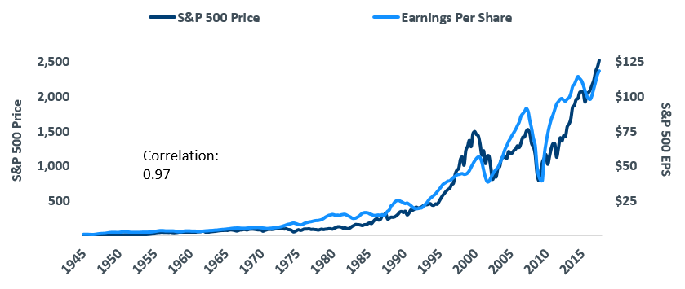
Overview
Known Correlation between earnings and share price
Goal: Find untapped value in the S&P 500 Index – Predict 5 year returns of Individual Stocks
Stocks with a high potential to go up based on earnings increases
https://www.calamos.com/blogs/voices/jpc-why-the-bull-market-can-continue/
Notes:
There is a known correlation between a company’s earnings and the value of its stock.
The graph to the right shows the S&P 500’s total EPS overlayed onto the S&P 500’s price
The Correlation is obvious, not a perfect fit, but it is there.
The question is: Can individual stock prices be predicted based on their historical earnings?
The goal is to find value in the S&P 500 index by predicting the 5 year return of individual stocks.

Slide 4
Previous Work
Y. Huang, S. Nakamori, and S.-Y. Wang, "Forecasting stock market movement direction with support vector machine," Computers & Operations Research, vol. 32, no. 10, pp. 2513-2522, 2005.
Predict stock market direction in Hong Kong and Korean Markets with factors including S&P 500 index and Exchange Rates from 2001-2011
P. C. Tetlock, "Giving Content to Investor Sentiment: The Role of Media in the Stock Market," The Journal of Finance, vol. 62, no. 3, pp. 1139-1168, 2007.
Explores social media and stock market activity interaction
Pessimism Factor – Trading on social media sentiment alone
Other papers and readings on the relevance of financial statements in making stock buy/sell decisions are also available, with no data mining relevance:
"Financial Statement Analysis and the Prediction of Stock Returns," Journal of Accounting and Economics
Notes:
Y. Huang, S. Nakamori, and S.-Y. Wang,
"Forecasting stock market movement direction with support vector machine,"
Able to do this prediction with individual stocks and indices HSI and KOSPI – Hong Kong and Korea, using a support vector machine
Utilized the S&P 500 index, Exchange Rates, and some other macro economic indicators
Verified that international markets have co-movement and correlation to each other
P. C. Tetlock, "Giving Content to Investor Sentiment: The Role of Media in the Stock Market," The Journal of Finance, vol. 62, no. 3, pp. 1139-1168, 2007.
Exploration of how social media impacts market pressures
High values of media pessimism induce downward pressure on market prices; and unusually high or low values of pessimism lead to temporarily high market trading volume.
Further-more, the price impact of pessimism appears especially large and slow to reverse itself in small stocks.
The study found that it is possible to construct a hypothetical zero-cost trading strategy using Negative words found on social media that yields returns as high as 7.3% per year
With little risk – High Portfolio turnover – Commission Costs high
This research was some degree of evidence that this is not a straightforward problem
J. Ou and S. H. Penman, "Financial Statement Analysis and the Prediction of Stock Returns," Journal of Accounting and Economics
Discussion about how changes in

Slide 5
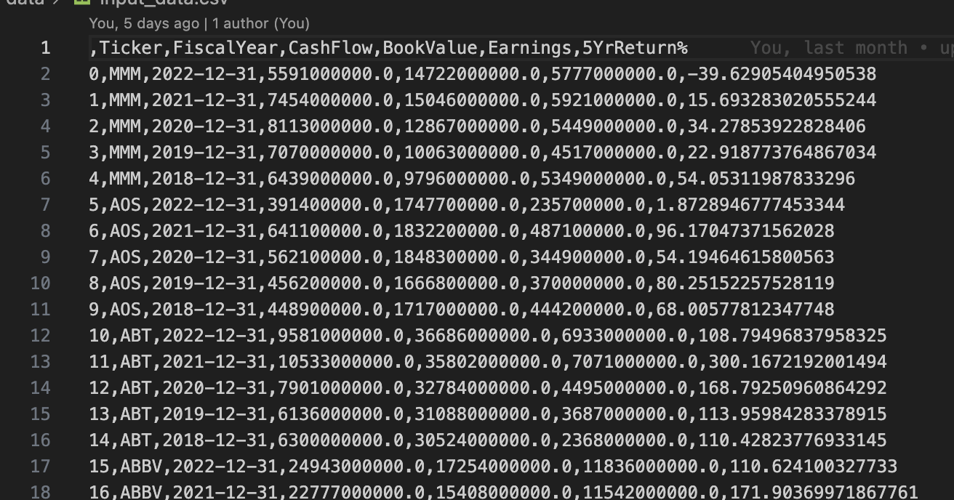
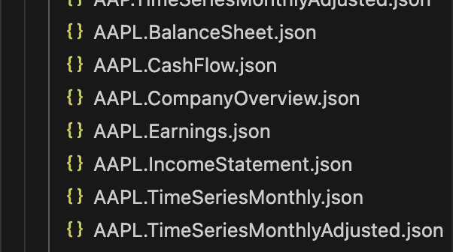
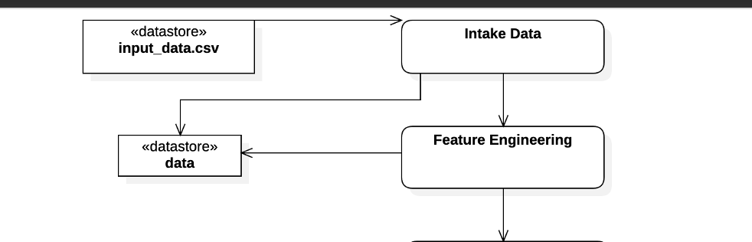
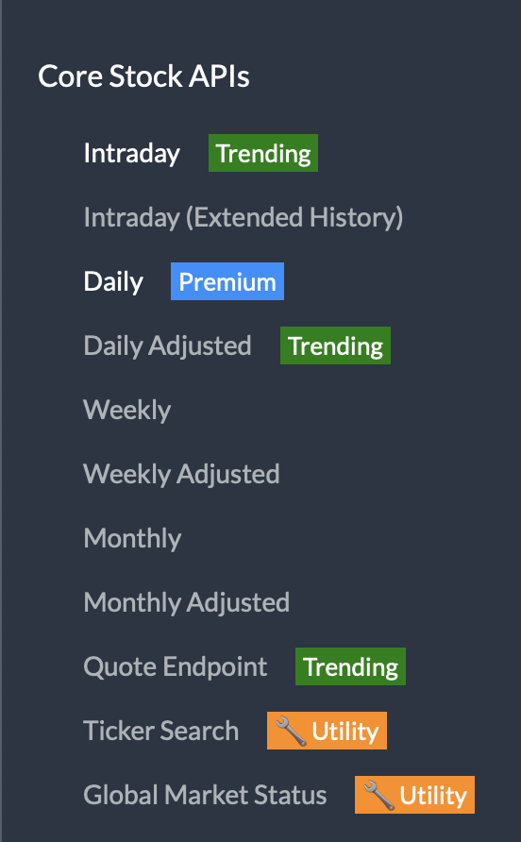
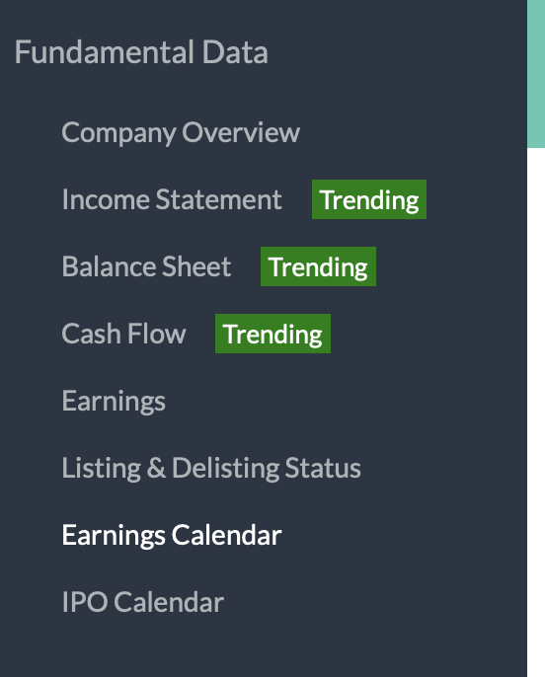
Data Collection
Alpha Vantage API
Collect JSON files for S&P 500
Convert to a CSV input to the experiment
Notes:
JSON files are collected from Alpha Vantage API – I put a red box around the functions I used from the API
Dozens of parameters contained in those files –
Choose relevant parameters and contain them into some kind of time series
CSV output contains: Ticker, Fiscal Year, Cash Flow, Book Value, Earnings, and 5 Year Return

Slide 6
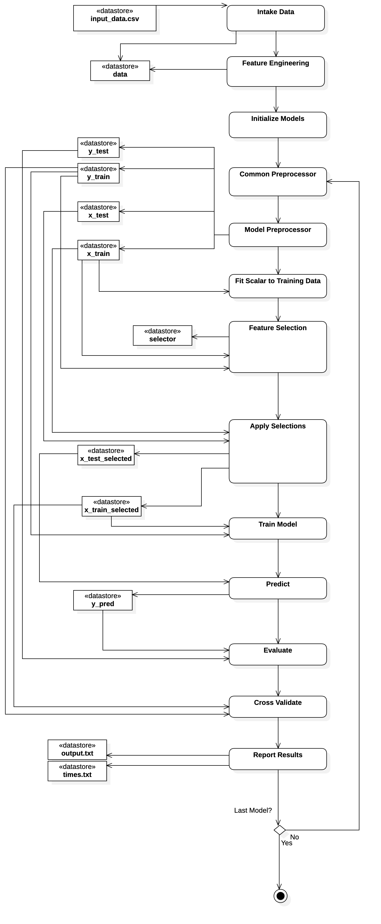
Experiment Design
Data Collection Not Reflected In Diagram
Data is split, Models are fit and trained
Prediction, Evaluation, Cross Validation
Output to Results Files
Compare results from Linear Regression, Random Forest, and Support Vector Machine
Notes:
Data intake
- Collected data → input CSV, data is loaded in.
- Feature engineering – enrich data with YOY growth rates for each parameter
- Initialize Models – Instantiate all of the Scikit learn models -- Linear Regression, Random Forest, and Support Vector Machine
- I feed the data through a common preprocessor which does more feature engineering with the addition of an Earnings_to_Book_Value parameter
- Each model then has the option to implement its own preprocessor, however I think I have left this blank in all cases, but after these two steps you have your split training and testing data.
- Outliers are removed from the training data, but not the testing data.
- I then fit a StandardScalar to the half of the training data
- Feature selection is a bit complex and it behaves differently for each of the three models tested –
- for support vector machine,I used SelectKBest,
- All others were RFE feature elimination
- These feature selections are then applied
- The model is trained
- Prediction is run
- The model is then evaluated and cross validated
- The results are then written to files, one containing the statistical metrics, and the other containing details about times required for training and predicting.

Slide 7
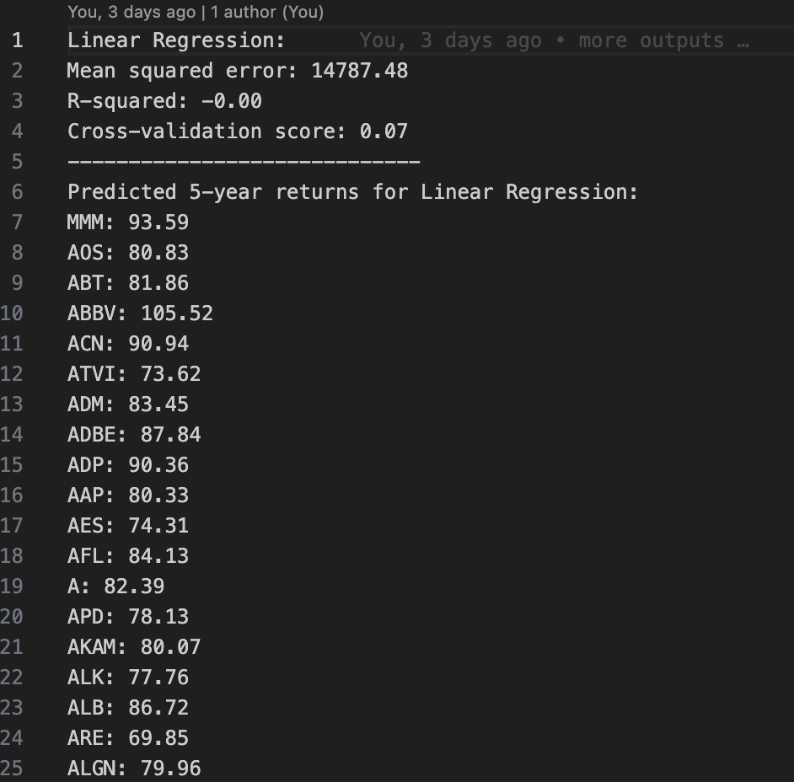
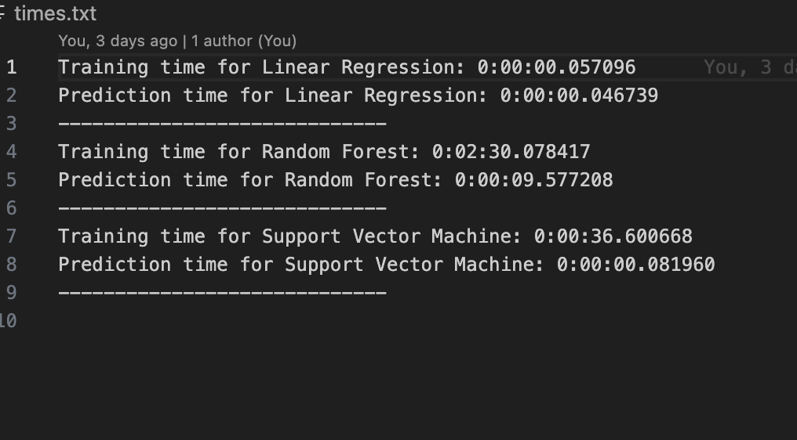
Experiment Outputs
Output.txt
Times.txt

Slide 8
Results
Model | Mean squared error | R-squared | Cross-validation score
Linear Regression: | 8857.39 | -0.01 | 0.02
Random Forest: | 7964.94 | 0.09 | 0.12
Support Vector Machine: | 8750.26 | 0.01 | 0.09
High Mean Squared Errors
R-Squared Very low for each model
Cross-Validation scores were low
Model | Training Time | Predicition Time
Linear Regression | 0:00:00.057096 | 0:00:00.046739
Random Forest | 0:02:30.078417 | 0:00:09.577208
Support Vector Machine | 0:00:36.600668 | 0:00:00.081960
Notes:
Not good.

Slide 9
Conclusions
This methodology did not accomplish the expected result of predicting 5-year stock returns with high accuracy.
All three models were under-fitted to the data
Cross validation scores showed that none of the 3 models performed well.
Feature engineering, variable selection, and data normalization are very important.
Financial markets are complex and unpredictable
Macroeconomic indicators, market sentiment, nor geopolitical events were considered
Notes:
This methodology was unsuccessful at predicting stock returns
All three models proved to be under fitted to the data
Cross validation scores showed that none of the models performed well, but that Random Forest performed the best of the 3
It is clear that feature engineering and variable selection are important, as these were largely the only reasons that I was able to get anything north of 0 for R2

Slide 10
Future Work
Data Enhancement
Data Imputation
Model Selection: Neural Networks, RNN’s, LTSM Networks
Better Hyperparameter Tuning
Hybrid Models
Notes:
Data Enhancement
- Further enrich the data with expanded historical range (longer-term trends)
- additional variables: market sentiment data, industry-specific indicators, and macroeconomic variables, such as GDP growth rate and inflation
Data Imputation
- I did a lot of simply removing or skipping over values that were problematic
- Find better ways to predict what the missing values should be
Better Hyperparameter Tuning:
- Bayesian Optimization
Model Selection
- Neural Networks, known for their ability to model complex, non-linear relationships, could potentially capture patterns in the data that were missed by the current models. Recurrent Neural Networks (RNNs) and Long Short-Term Memory (LSTM) networks could be especially useful for this time-series prediction problem [8][9].

